Slide 1

Stored Procedures
The Good, the Bad and the Elegant
Harry Pierson, Staff Engineer
harry.pierson@dbos.dev
@DevHawk

Slide 2
Agenda
Welcome
Stored Procedures
  The Good
  The Bad
  The Elegant
Demonstration
Q&A

Slide 3
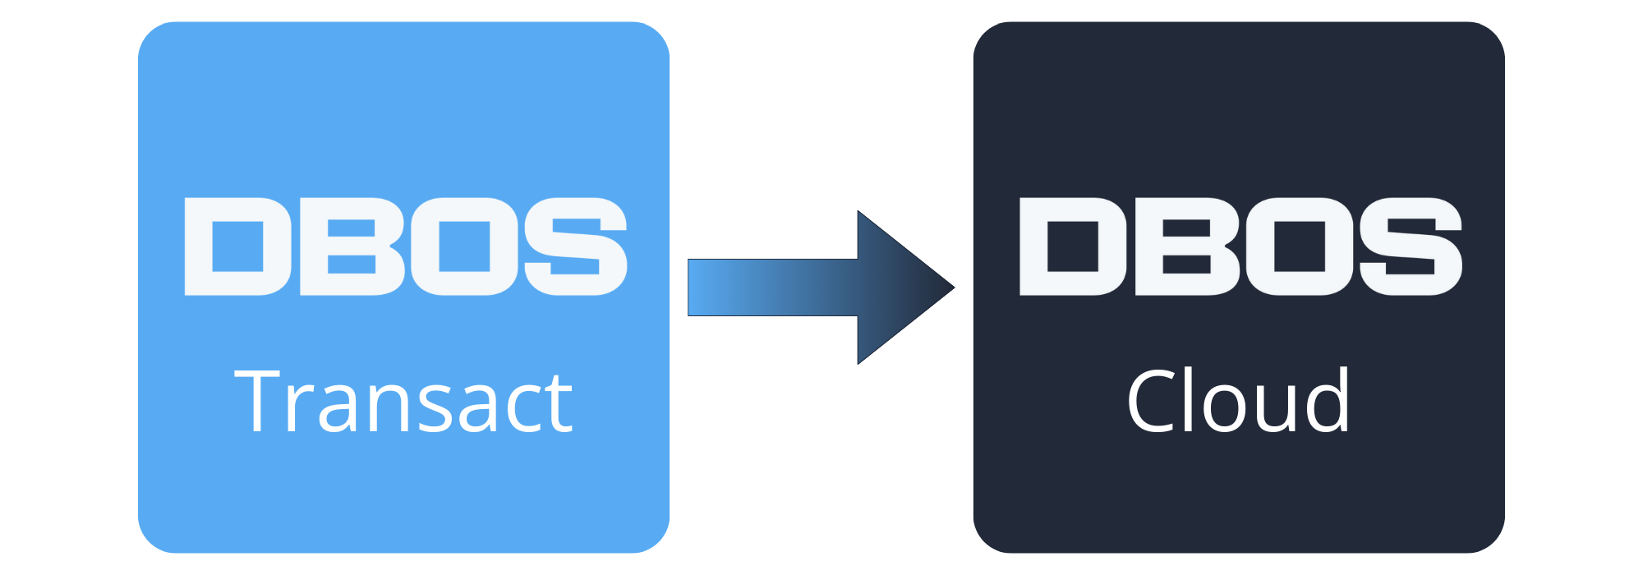
About DBOS
Open source framework
  Easier backend development
  Reliable, Observable, Performant
  10x less code
  TypeScript, Python (soon)
Stateful serverless platform
  15x more cost-efficient than AWS Lambda & Step Functions
Use it for free!
Build
Deploy

Slide 4
<personal-anecdote />
Notes:
I like to start my presentations with a personal anecdote. A story related to the topic at hand. But I’m not going to do that today. I *CAN’T* do that today. Because even though I’ve been a developer in the IT industry for over three decades, I have *NEVER* written a stored procedure for production use.
I’ve built many database applications. I was at MSFT for 21 years, a third of that working with enterprise customers primarily building database applications. I’ve read docs and done the labs and tutorials. I am familiar with half a dozen object relational mapping systems across multiple languages. But I’ve never built a production stored procedure ever.
I’m pretty sure I’m not alone in this. So, let’s talk about it.

Slide 5
Everybody knows the benefits of using Stored Procedures.
Performance and
Scalability
Notes:
Stored procs are proven, mature and battle tested technology. They have a variety of upsides. In particular, they are *FAST* <*CLICK*> both in terms of raw performance and scalability.
Those are two metrics you probably care about a lot if you’re an app developer. Faster apps tend to have happier users. Scalable apps require less infrastructure, so they cost less to operate.
It’s easy to understand what makes stored procs fast. If you run your business logic – which is to say, your data query and manipulation logic –closer to your data, you spend less time traversing the network.
The physical database operations – inserting rows, scanning table indexes, stuff like that –take the same amount of time regardless of where the query originates. However, queries that originate on the app tier each require a separate network round trip. The cost of these network round trips may be small, but it’s not zero and they do add up.
To see what I mean, let’s look at some sample code.

Slide 6
3️⃣
BEGIN TRANSACTION;
< OAOO: check for previous execution >
INSERT INTO orders
(last_update_time, order_status, username)
VALUES ($1, $2, $3) RETURNING order_id;
INSERT INTO order_items
(order_id, price, product_id, quantity)
VALUES ($1, $2, $3, $4), ($5, $6, $7, $8), ...;
< OAOO: save function result >
COMMIT TRANSACTION;
6️⃣
1️⃣
2️⃣
5️⃣
Once And Only Once
4️⃣
(OAOO)
Notes:
<SQL from demo app, get from GitHub, create order function, shop sample>
< discuss KNEX, mention DBOS supports multiple ORMs and that this is the generated SQL since we’re taking a database perspective>
< order entity modeled as two tables w/ a many to one relationship. Autoincrement order_id PK returned by first query, used by second. Dependency requires sequential execution>
<talk about atomicity>
Making this operation atomic is important, but it’s not sufficient for reliability. Creating an order is one small step in a larger process – or to use DBOS terminology, a workflow. The business expects each step of this workflow to execute once and only once. The business wants to create the order once, charge the customer’s credit card once, ship the order to the customer once.
However, computers can’t guarantee steps happen once and only once. Computers are fallible. Hardware fails. Operating Systems fault. Networks lose connection. Security companies push untested patches. These are some of the infinite number of things that can go wrong and cause your application to fail and restart. When that happens, you need to know which steps of a given workflow have already been executed so the interrupted workflow can be completed correctly.
< talk about save/retrieving function result >

Slide 7
“Physical separation causes high communication overhead: in our experiments with OpenWhisk, communication accounts for as much as 98% of function runtime.”
“Apiary: A DBMS-Integrated Transactional Function-as-a-Service Framework”
https://arxiv.org/abs/2208.13068
Notes:
For those who don’t know, DBOS started as a research collaboration between MIT and Stanford university. One of the research projects was Apiary, a transactional Function-as-a-Service framework that was the precursor to

Slide 8
Everybody knows the benefits of using Stored Procedures.
Almost
^
Nobody thinks those benefits are worth it.

Slide 9
Stored Procedure Friction Points
They aren’t written in same language as your application
They don’t integrate into your existing developer workflow
They aren’t versioned the same way as your application
They are hard to debug
These don’t seem like
show-stoppers…

Slide 10
DBOS @StoredProcedure
All the performance … None of the friction

Slide 11
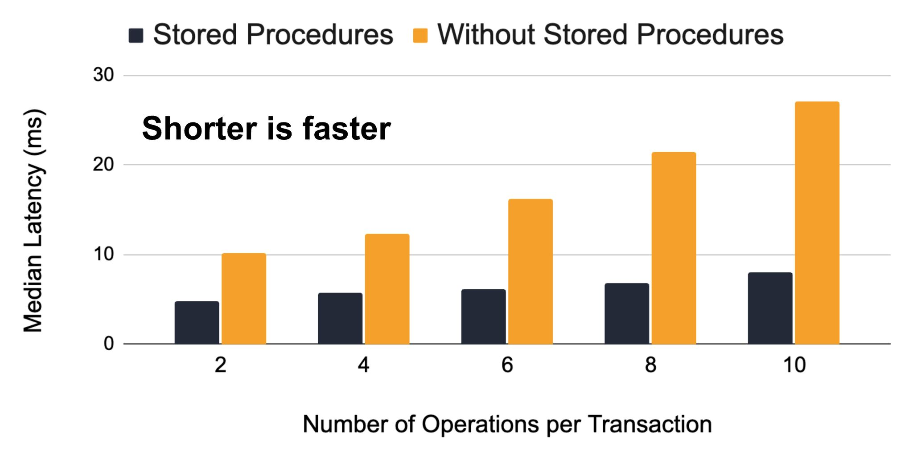
All the Performance…
https://github.com/dbos-inc/dbos-stored-proc-benchmark

Slide 12
…None of the Friction
They aren’t written in same language as your application
DBOS @StoredProcedures are written in TypeScript
They don’t integrate into your existing developer workflow
  DBOS @StoredProcedures are written inline with your other
  DBOS application logic
They aren’t versioned the same way as your application is
Deployed DBOS @StoredProcedures can be version stamped
They are hard to debug
A DBOS @StoredProcedure can be executed locally during debugging

Slide 13
@Transaction()
static async createOrder(
ctx: TransactionContext<Knex>, username: string, products: Product[]
): Promise<number> {
const orders = await ctx.client<Order>('orders’)
.insert({ username, order_status: PENDING,
last_update_time: 0n })
.returning('order_id’);
const order_id = orders[0].order_id;
const items = products.map(p => ({ order_id,
product_id: p.product_id, price: p.price, quantity: p.inventory}));
await ctx.client<OrderItem>('order_items').insert(items);
return order_id;
}

Slide 14
@StoredProcedure()
static async createOrder(
ctx: StoredProcedureContext, username: string, products: Product[]
): Promise<number> {
const query = "INSERT INTO orders (last_update_time, order_status, username)
VALUES ($1, $2, $3) RETURNING order_id";
const orders = await ctx.query<Pick<Order, 'order_id'>>(query,
[0n, PENDING, username]);
const order_id = orders.rows[0].order_id;
for (const p of products) {
const query = "INSERT INTO order_items (order_id, product_id, price, quantity)
VALUES ($1, $2, $3, $4)";
await ctx.query(query, [order_id, p.product_id, p.price, p.inventory]);
}
return order_id;
}
Notes:
< Talk about differences between stored proc and tx context >
< talk about need to use raw SQL (PLv8 is not node compatible) >
< Talk about the ability to execute multiple queries >

Slide 15
DBOS Compiler, Under the Hood
Extracts @StoredProcedure methods
  Eliminates DBOS methods except @StoredProcedure
  Tree shakes out code that isn’t used by @StoredProcedures
  Convert await calls to be synchronous (plv8 limitation)
  Removes decorators
  Compiles remaining code to JavaScript via TSC
Generate Functions and Stored Procedures
  Every module becomes a plv8 function
  Every @StoredProcedure function becomes a plv8 function and a pl/pgSQL stored procedure
  Generated functions/procedures get optionally version prefixed

Slide 16
@StoredProcedure Demo
Notes:
In the demo, I plan to show the stored-proc version of the original widget demo. I have created a public repo in my personal github account

Slide 17

Good
Bad
Elegant
Stored Procedure Performance
Stored Procedure Developer Experience
DBOS @StoredProcedure
harry.pierson@dbos.dev
@DevHawk

